Slide 1
NPS - Mobile Application

Slide 2
Log in and Home
2

Slide 3
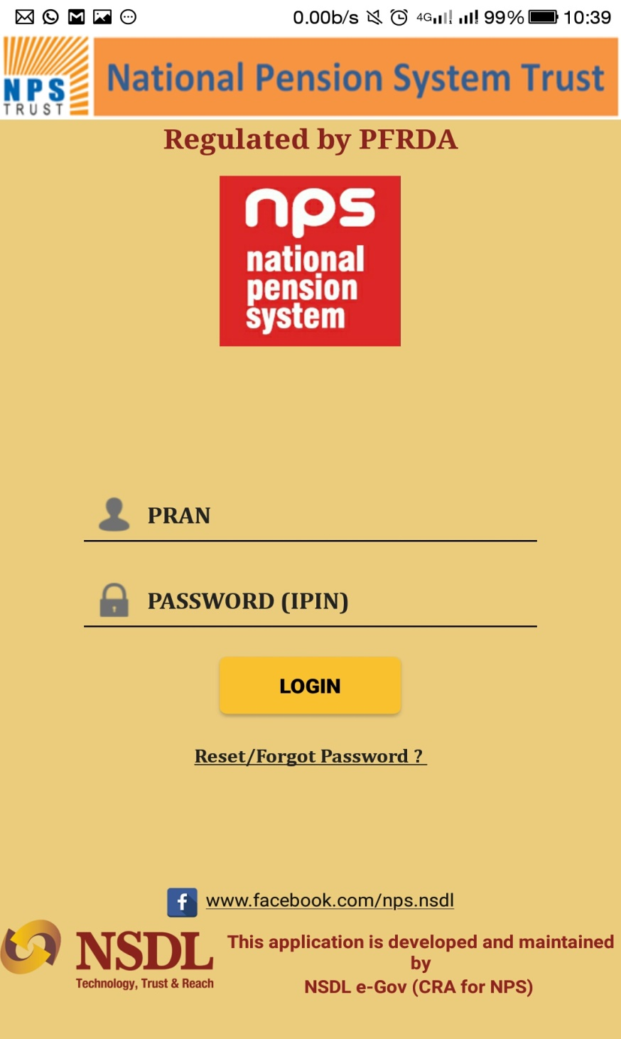
Log in and Home
3

Slide 4
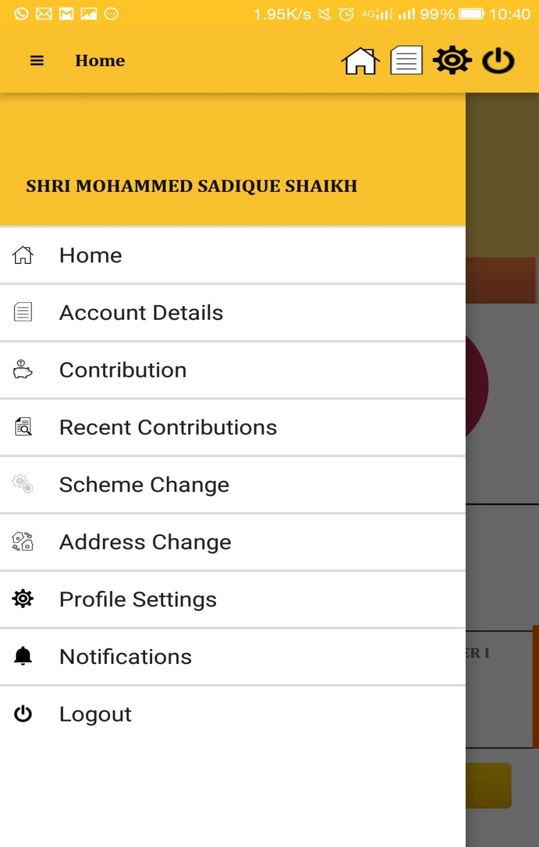
Menu

Slide 5
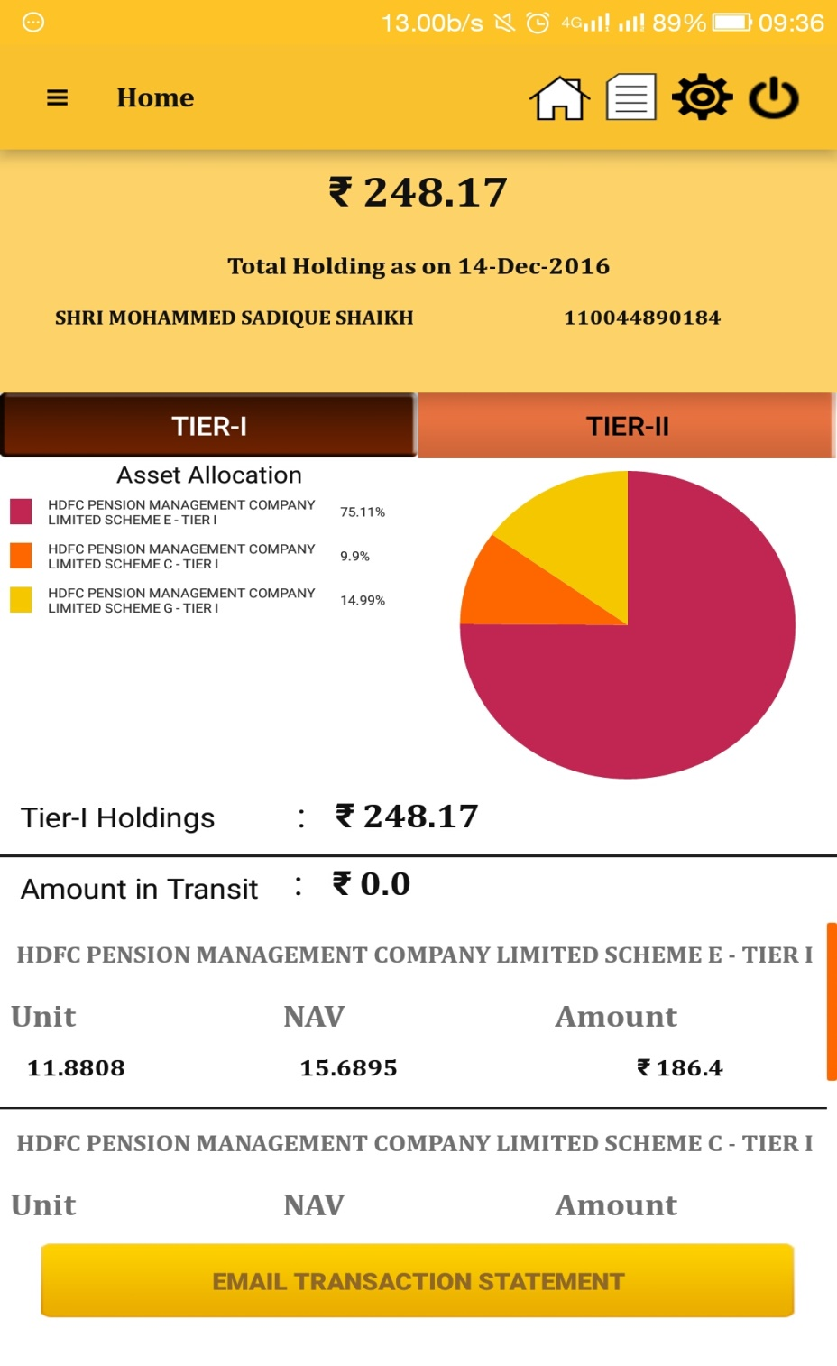
Home page
5

Slide 6
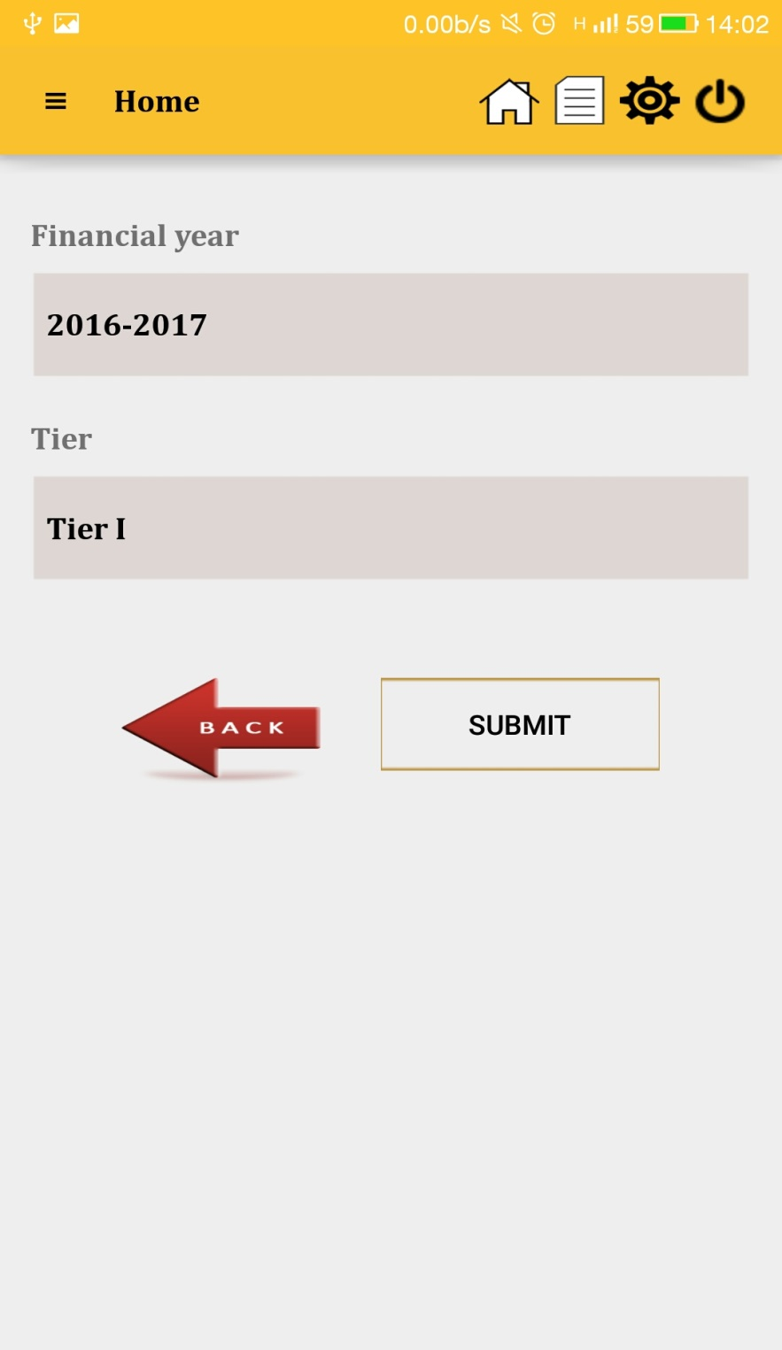
Transaction Statement Request
6

Slide 7
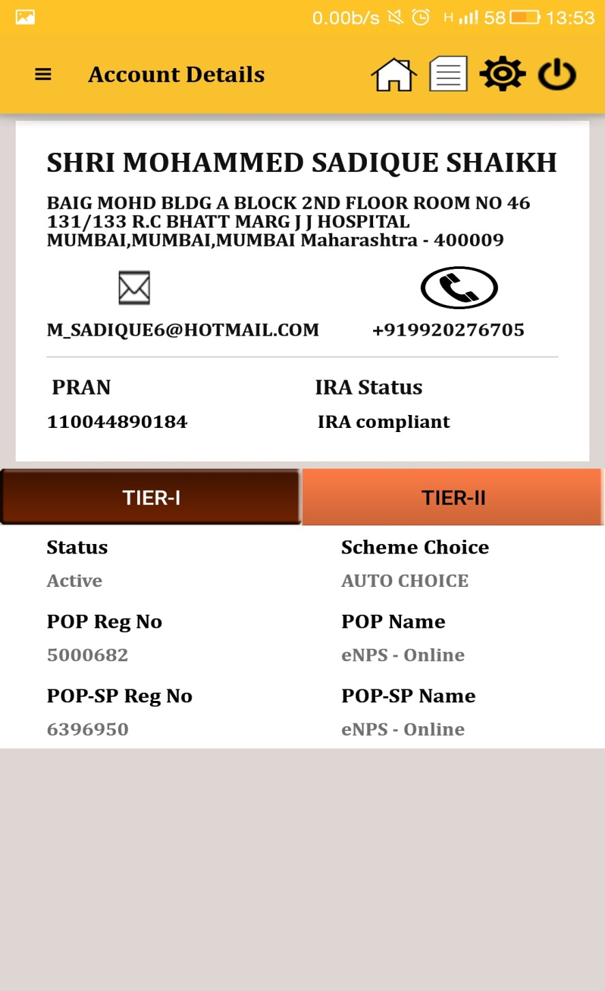
Account Details
7

Slide 8
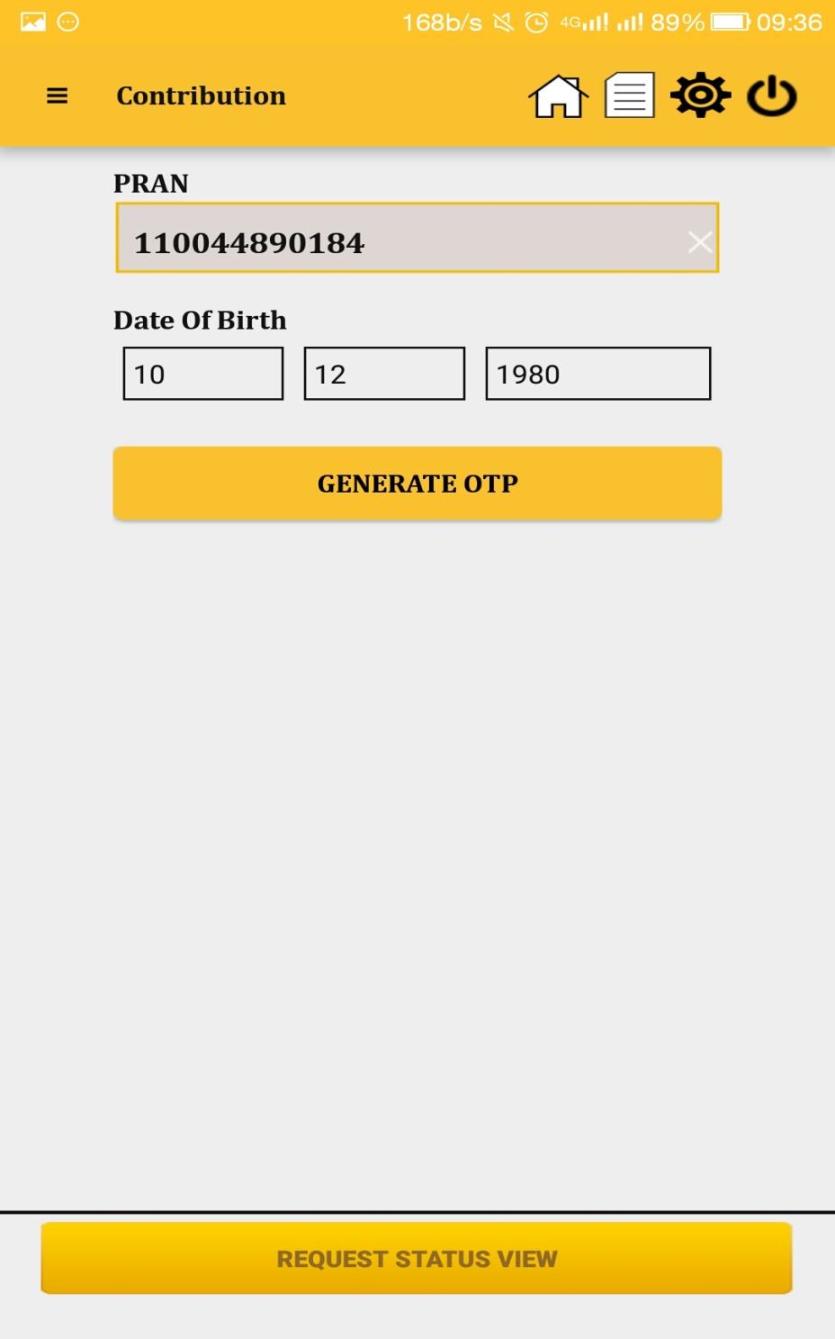
Contribution

Slide 9
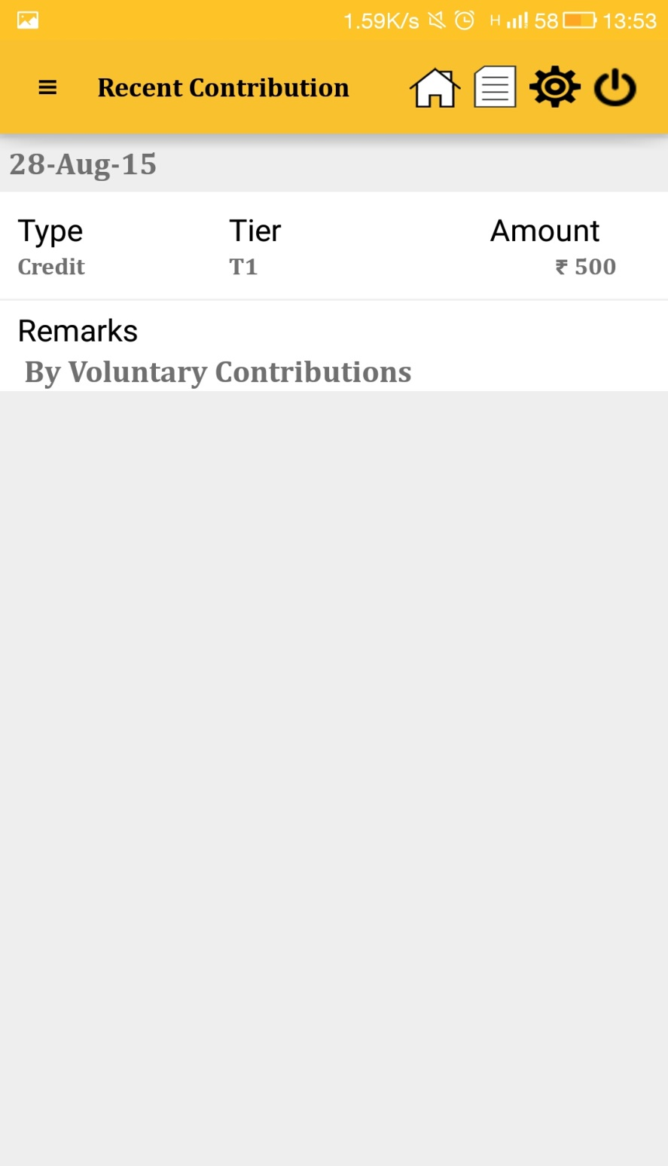
Recent Contribution
9

Slide 10
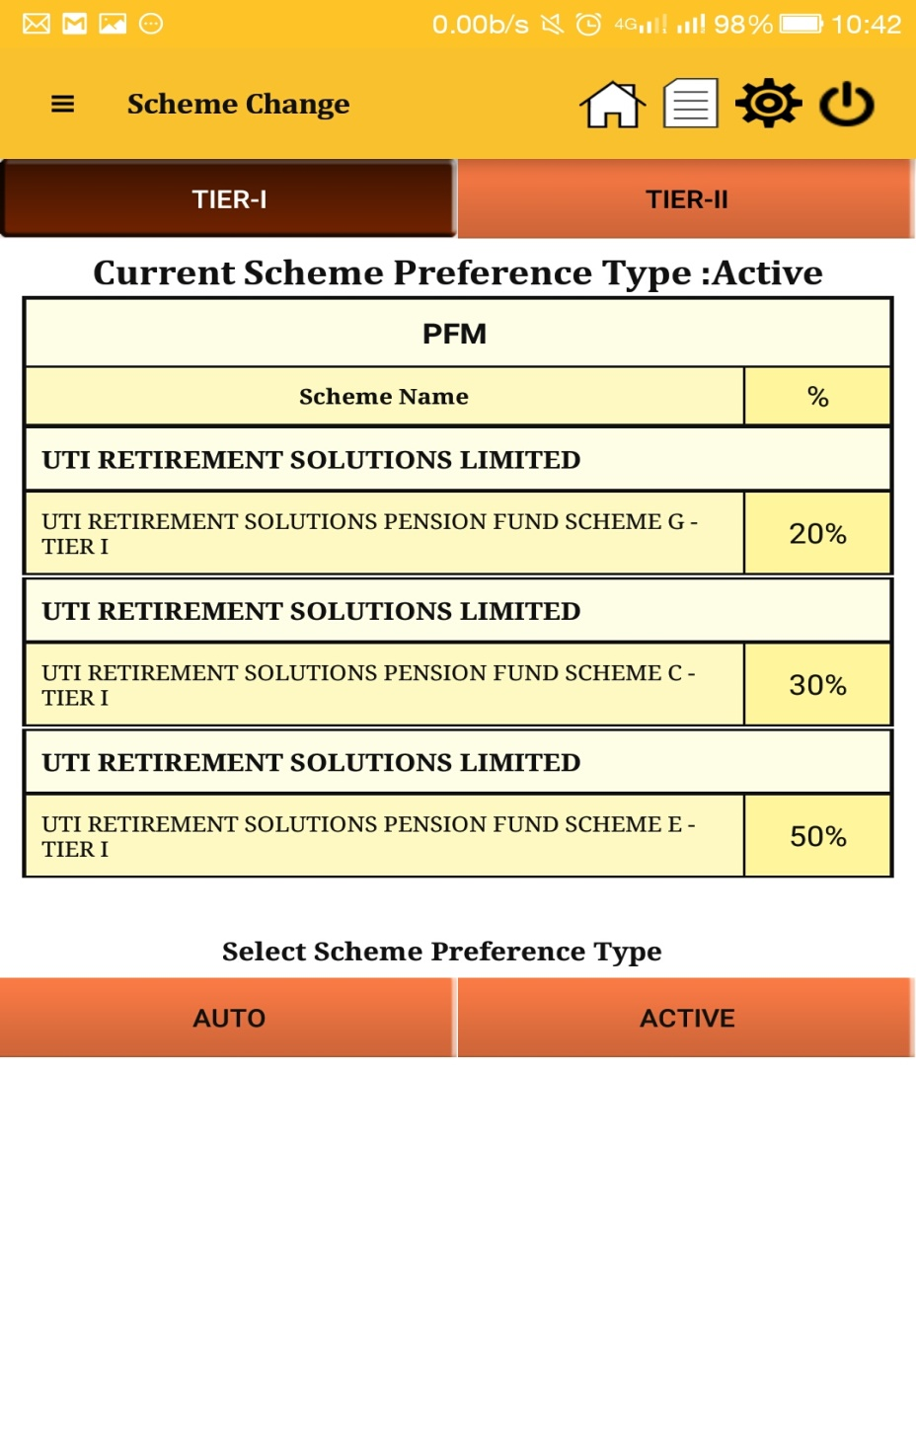
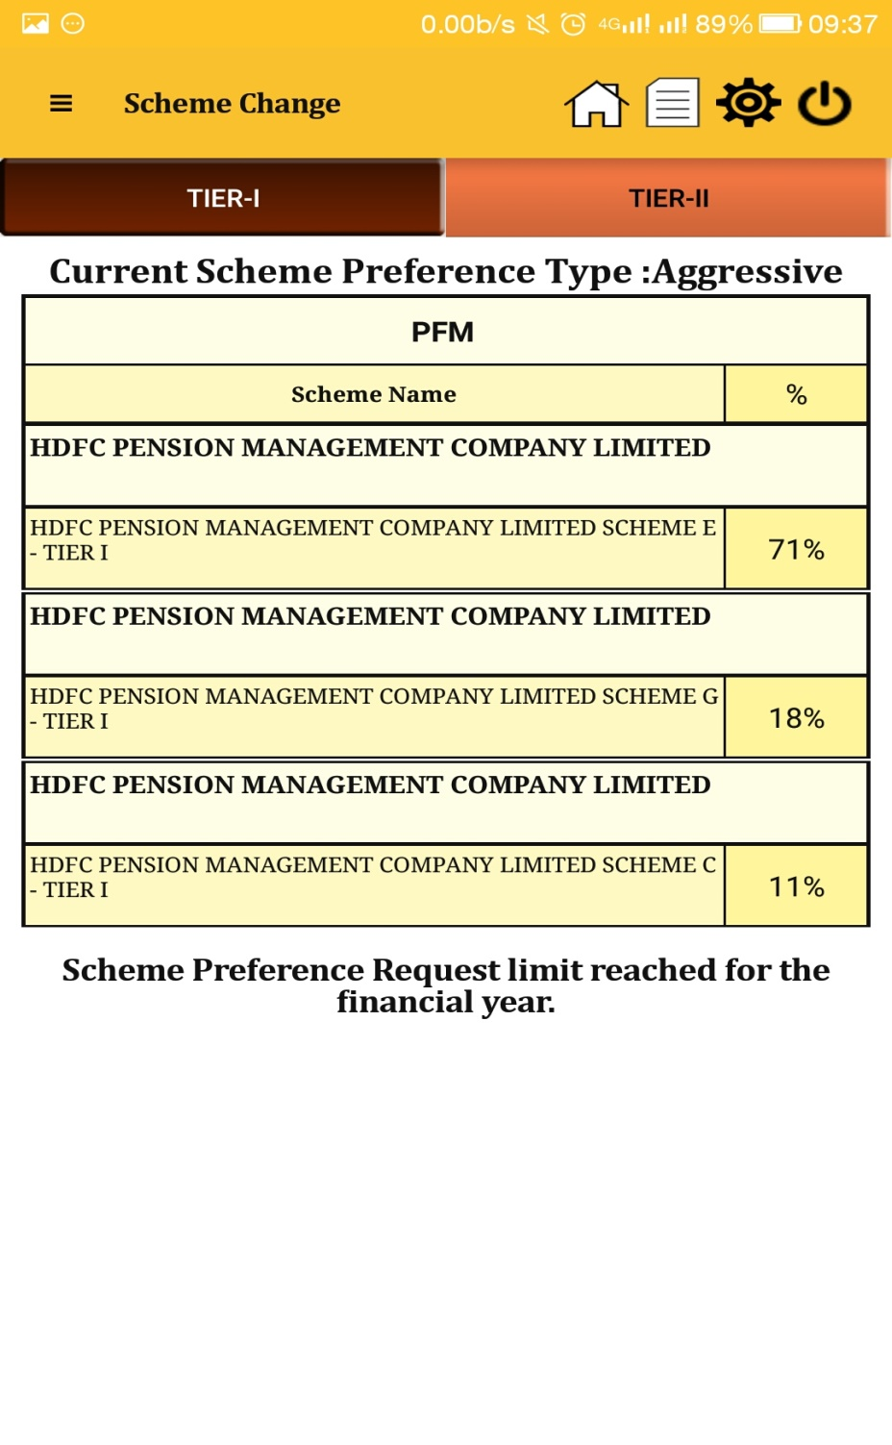
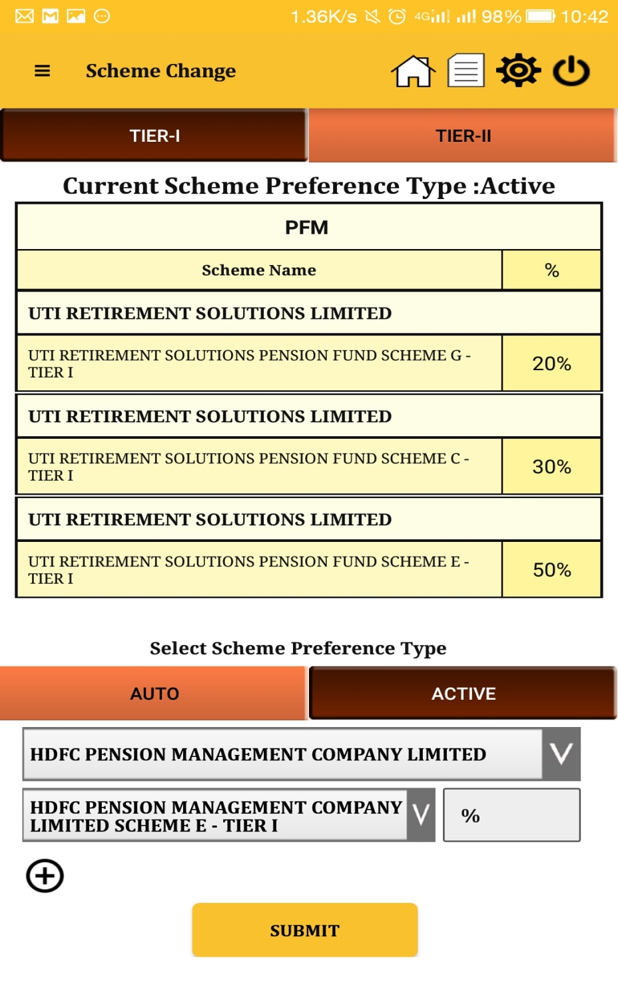
Scheme Preference Change

Slide 11
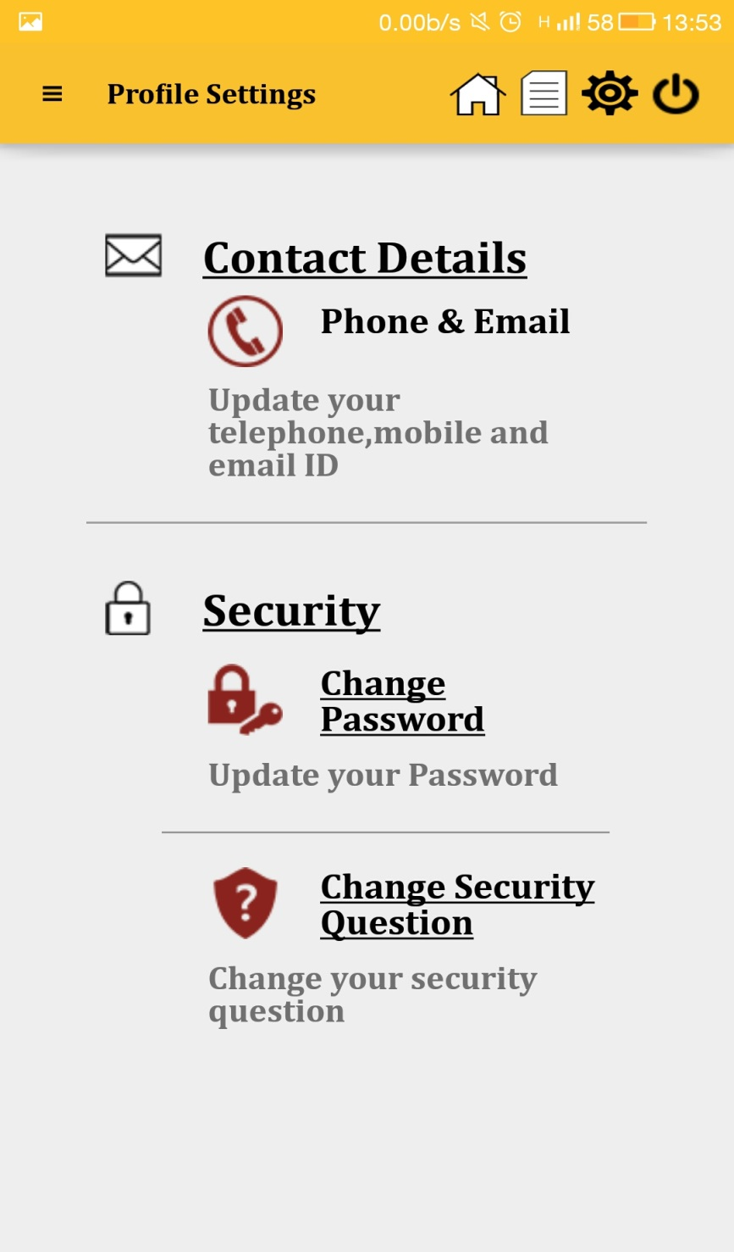
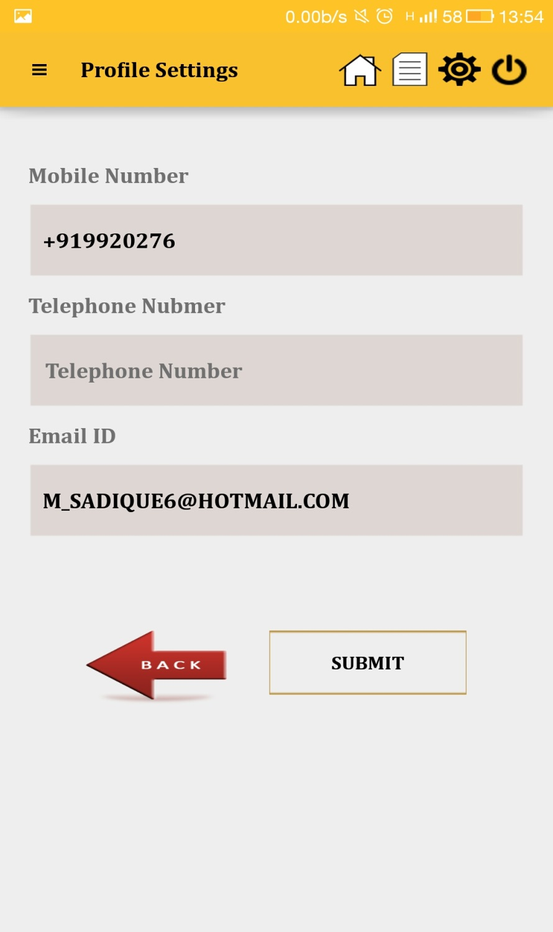
Profile Setting
11
Notes:
In an effort to provide a platform for planned retirement to the working population (including the government employees), the National Pension System was envisaged. NPS is based on the principal of defined contribution wherein the subscriber and / or employer contributes regularly which results in a substantial corpus for meeting up the expenses during post retirement period. NPS is quite unique in terms of the investment lifecycle coupled with the flexibilities it offers to Subscriber. A subscribers’ association with NPS typically ranges for decades. It is a product designed to cover the “risk of living”, wherein an insurance product typically covers the “risk of death”. Unlike MF product, there is flexibility of changing PFM and option to customize asset allocation.
As we proceed, we will discuss in detail the various options that the subscribers have.
The scheme was launched form January 1, 2004 for all central government employees (except for the armed forces). It was optional for the State Governments. As of now, 29 States and UTs have adopted NPS for their employees and are in different phases of implementation. Subsequently, from May 2009, it was made available to the common man.
As on date there are more than 7 million subscribers registered in CRA system. With the constant increase in the corpus and the Subscriber base which the Government sector is significantly contributing towards the fund and administration cost are bound to go down with the benefits ultimately to the Subscriber.

Slide 12
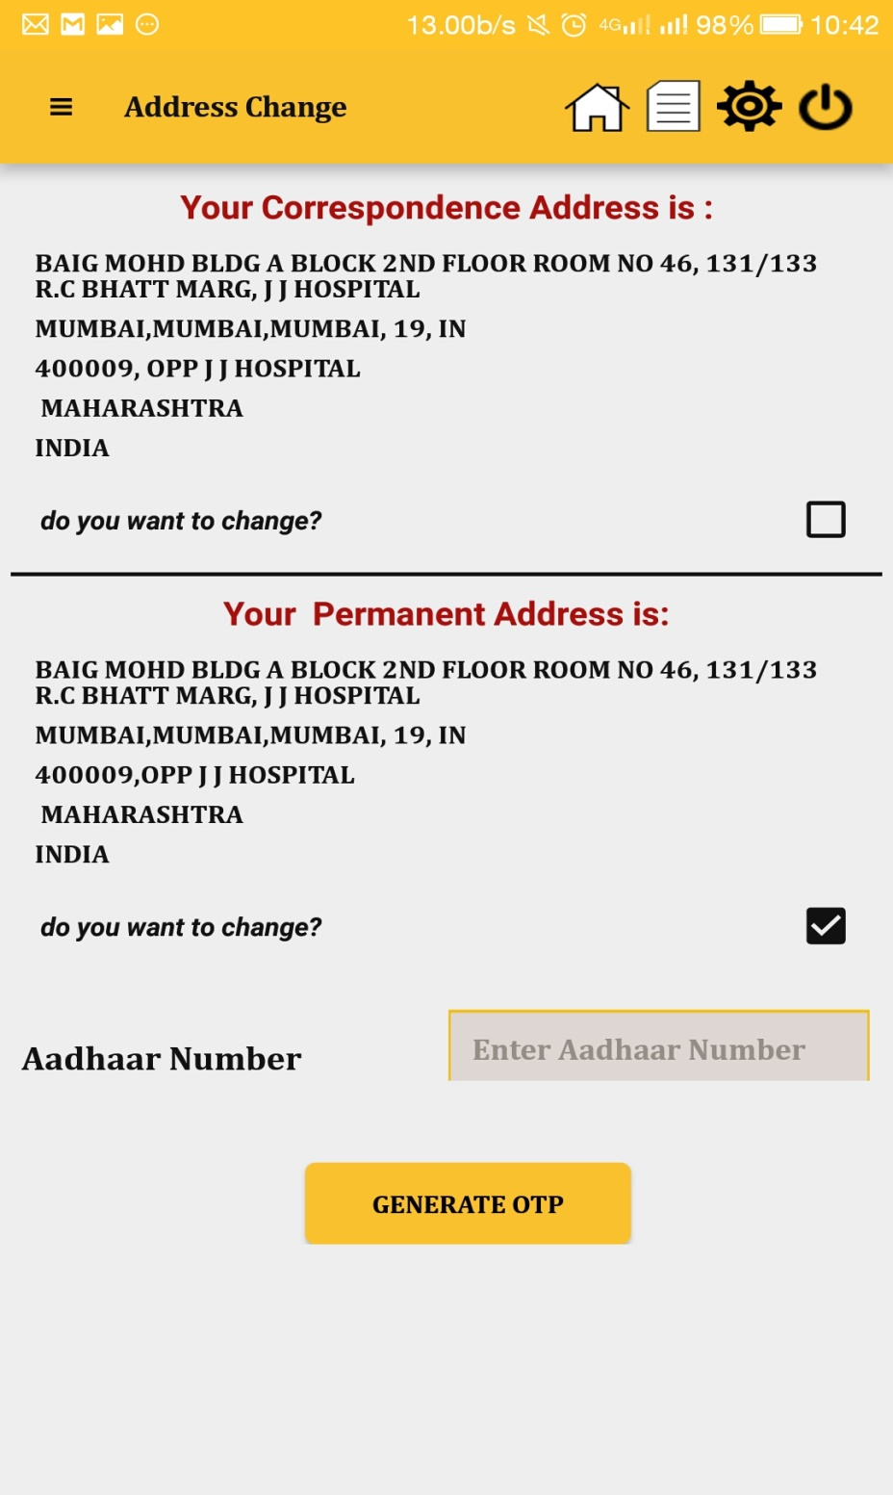
Address Change

Slide 13
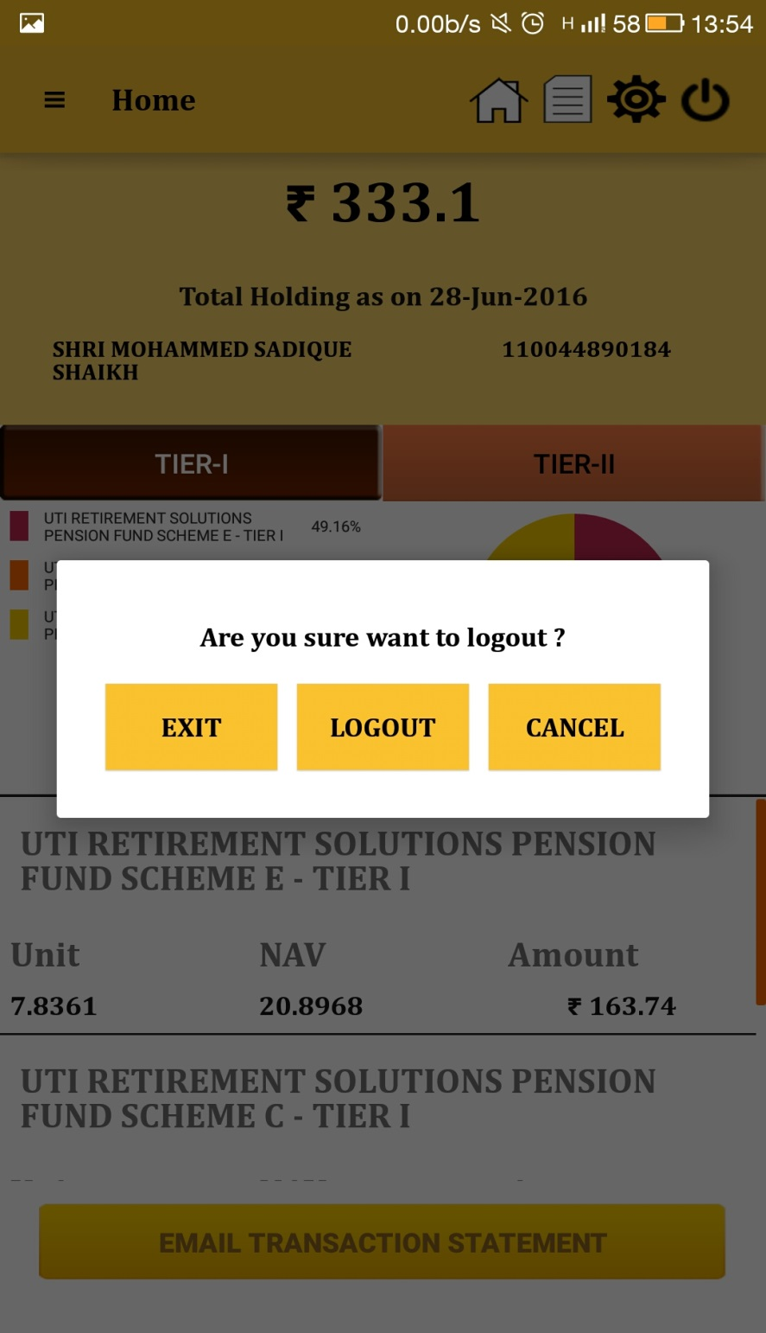
Log out
13

Slide 14
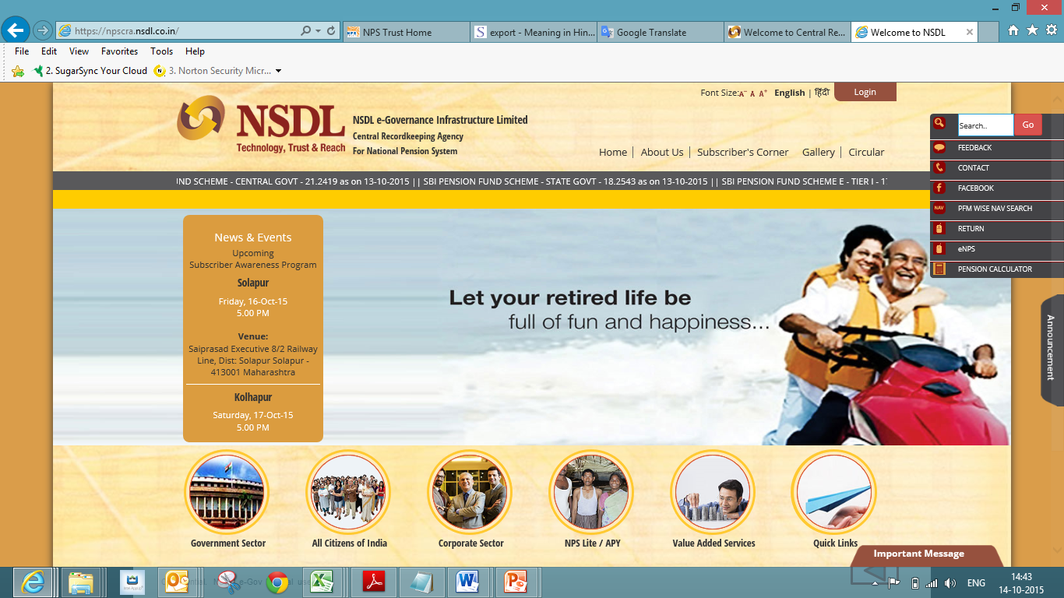
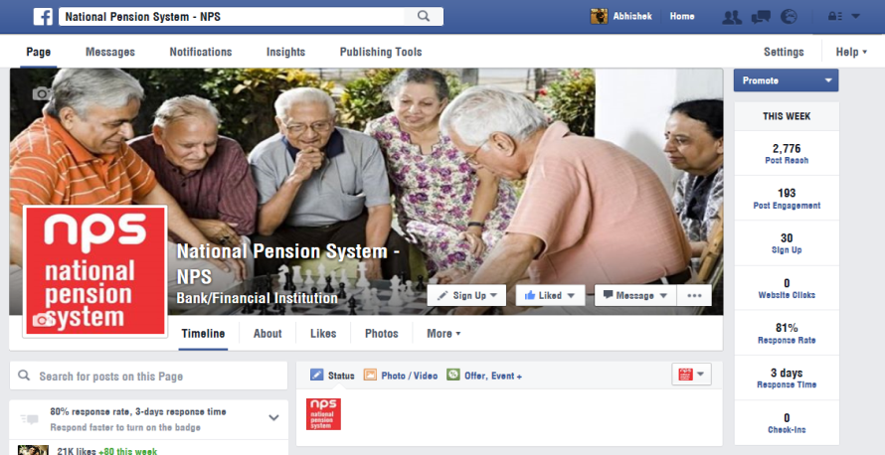
Let’s keep in touch
www.npscra.nsdl.co.in
facebook.com/nps.NSDL
Tel: 022-24994200
Helpline-:1800 222 080
Email: info.cra@nsdl.co.in

